Slide 1

Nabila Ahmed's Presentation

Slide 2
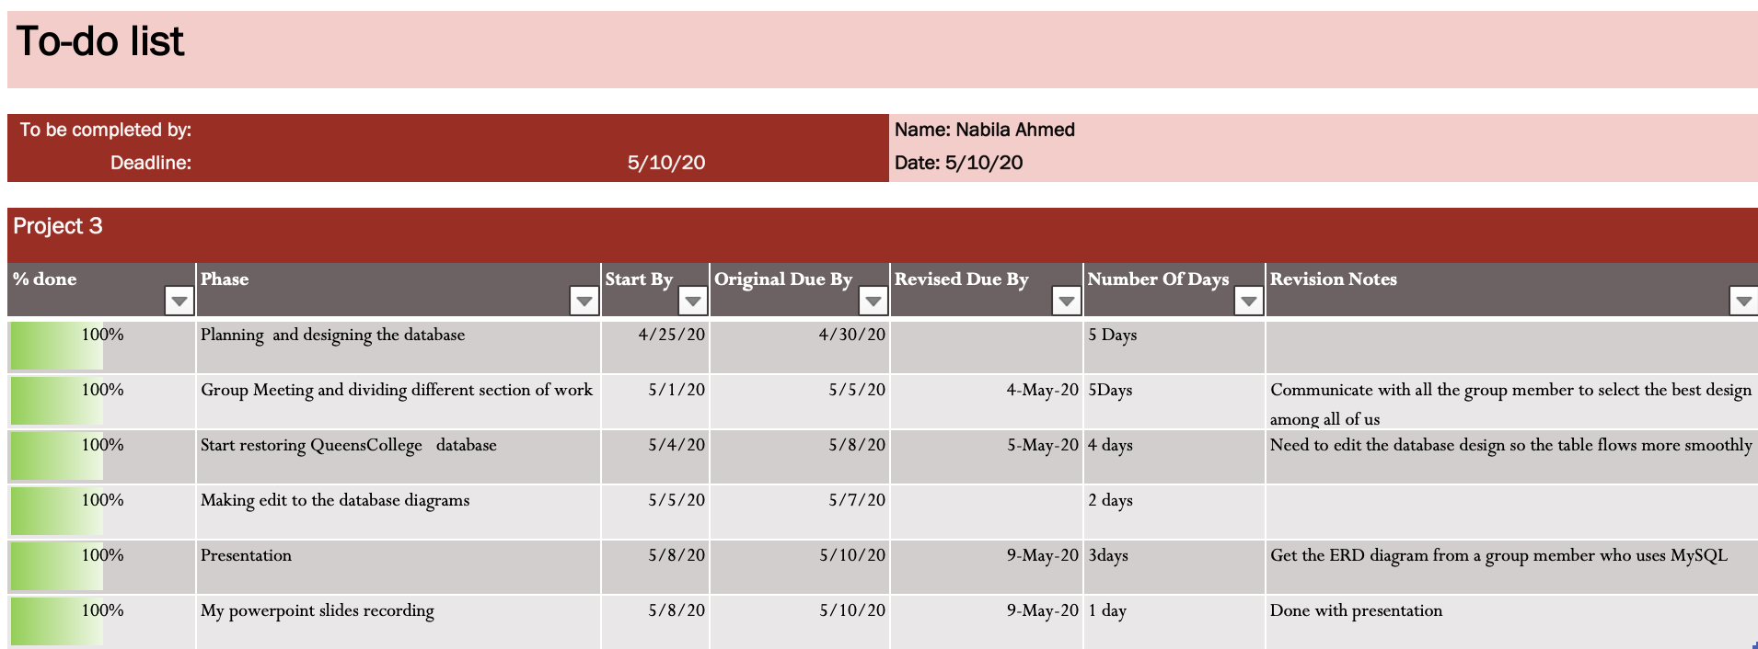
My to-do list

Slide 3
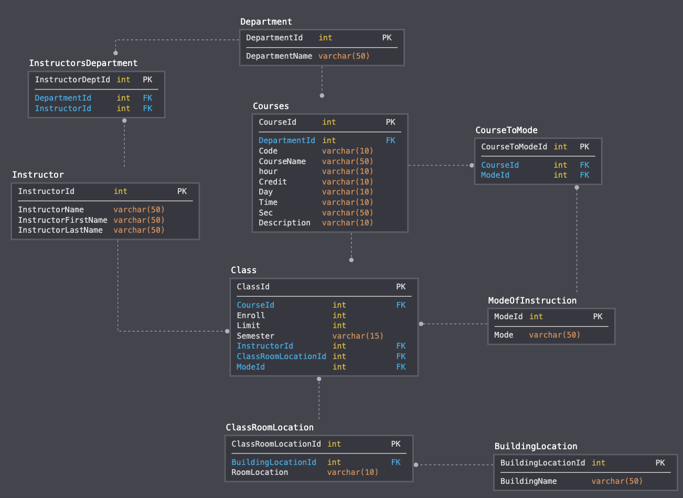
Design of the database in sqldbm

Slide 4
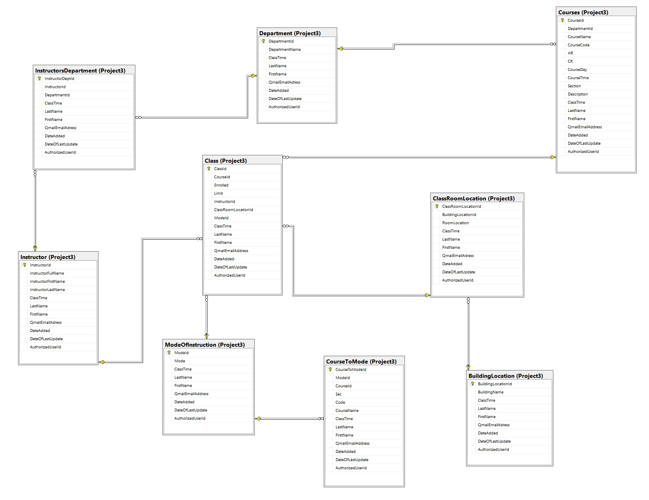
ERD Diagram in SSMS

Slide 5
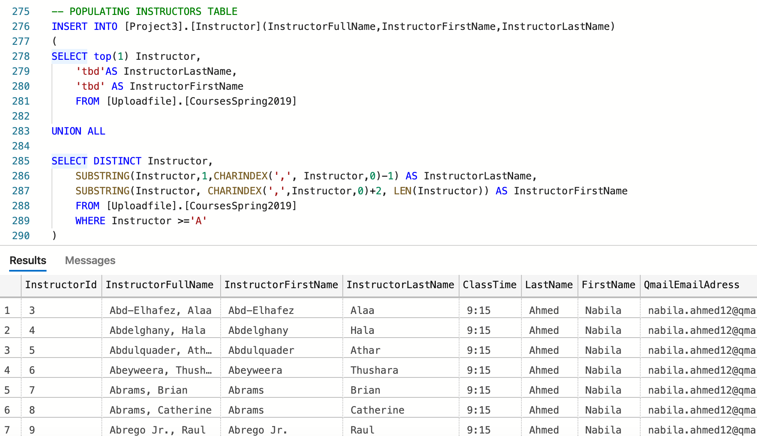
Populating Instructor Table

Slide 6
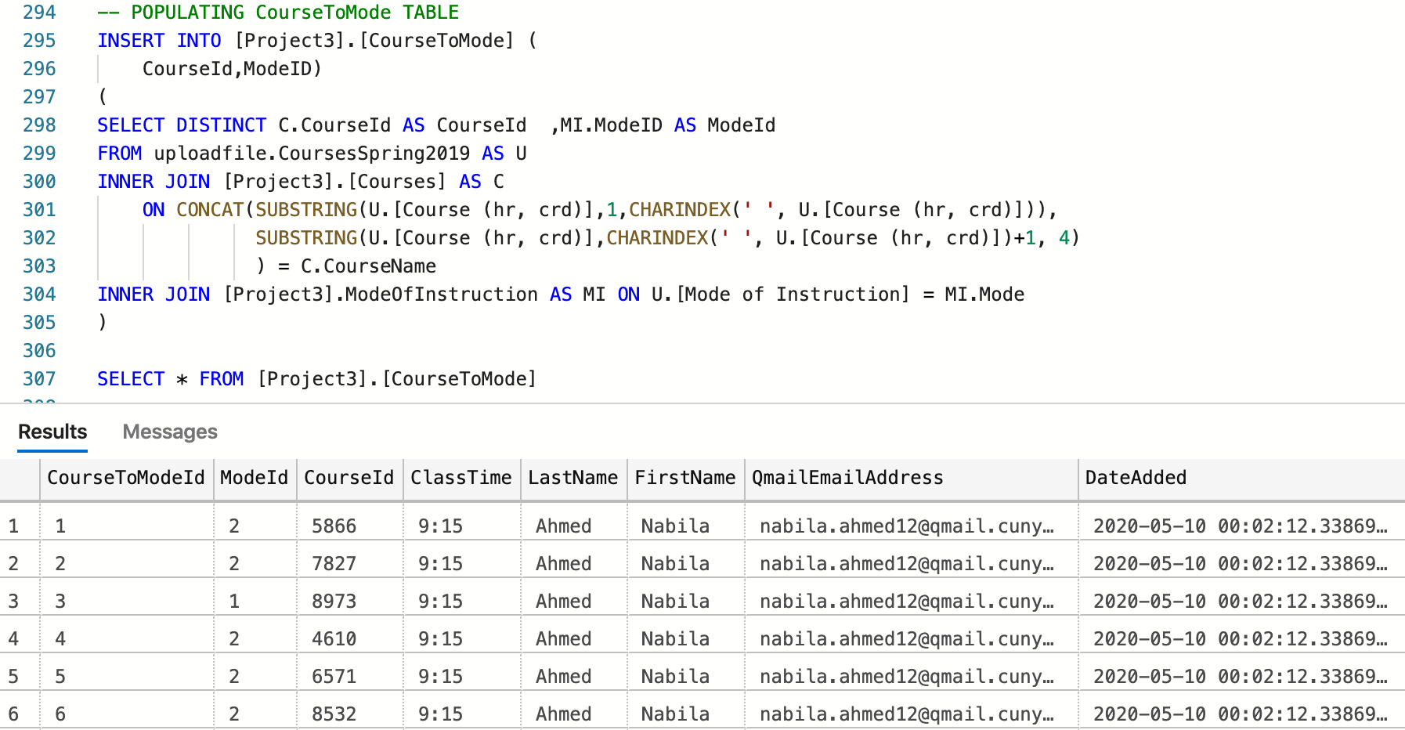
Populating CourseToMode Table

Slide 7
Conclusion
Learned how to create a database design sqldbm.
Made sure all tables and column names were in PascalCase.
Created primary key in each table and added Foreign keys to tables based on the ERD diagram.
Used a simple data Scripter to script tables and altering the table information's as needed.
Improved critical thinking skills and by doing this project got an understanding of how people in cooperate field might think to complete a project.

